Slide 1

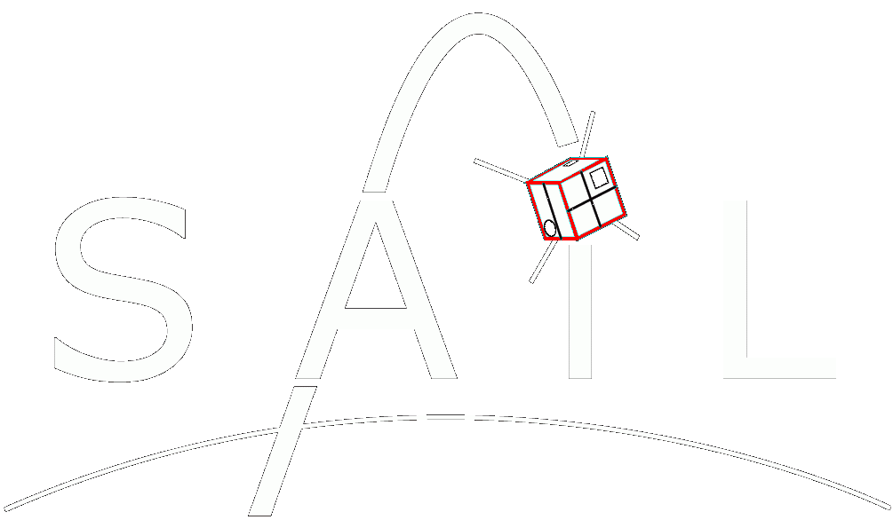
COMPASS
Computational Photometry Analyzer for Small Satellites

Slide 2
Overview
The Computational Photometry Analyzer for Small Satellites(COMPASS) is a desktop-based rendering engine written in C++ and OpenGL used to produce accurate graphical representations of RSOs (resident space objects) and their environments as observed by ground-based telescopes. These renderings are generated and processed within the program in order to infer additional information about the system including photometry data, RSO attitude, rotation frequency, etc. and provide a platform for testing image processing algorithms. An intuitive user interface is provided in order to visually correlate these renderings to the associated photometry data.

Slide 3
Project Requirements
No. | Description
1.0 | The program shall produce accurate renderings of RSO’s.
2.0 | The program shall provide a pass mode whose purpose is to produce and record accurate photometry data given a satellite’s shape, orbit, and rotation as well as the time of observation and location of the observer.
3.0 | The program shall provide a manual mode in which the user may define the simulation parameters and see their effects on photometry data.
3.1 | The user shall define the incoming light direction as well as the RSO shape, initial orientation, angular velocity, and altitude at any given time.
4.0 | The program shall provide a playback mode in which previously recorded simulation data will be used to render the RSO and live graph.
5.0 | The program shall provide a reconstruction mode in which the attitude or shape and attitude of the RSO will be generated according to recorded photometry data.
6.0 | The program shall provide render modes which determine the graphical representation of the RSO during a simulation.
6.1 | The Photometry render mode shall provide an “up-close” rendering of the RSO for the purpose of generating photometry data.
6.2 | The OSCOM render mode shall provide a “telescope view” rendering of the RSO for the purpose of simulating the OSCOM system and supporting image processing algorithms within the project.
7.0 | The program shall provide run modes which determine the speed and accessibility of each simulation.
7.1 | The Real-Time simulation mode shall render simulations in real-time for the user to observe
7.2 | The Back-End simulation mode shall render simulations as fast as possible without displaying them to the screen. These renderings are recorded and may be observed in playback mode.
8.0 | The program shall provide a graphical user interface in which simulations are rendered and photometry data is displayed

Slide 4
Additional Implementations
OSCOM simulator and testing platform. Virtually implementing new utilities/techniques within OSCOM such as OpenCV applications (automatic tracking software) or new equipment (simulate filters, telescope optics, cameras, etc.).
Research aid. Provides a more intuitive understanding of how spacecraft configurations (orbit, attitude, rotation, etc.) correlate to light curve data and provide a means of interacting with the scenario to quickly and easily test/explore new ideas.
CubeSat development. Test CubeSat models and configurations within the software in order to optimize their design for use with OSCOM.

Slide 5
Current State
Written in Java (because I used it for my CS225 project). Will start porting to C++ soon for added performance, using QT windowing/GUI system, OpenGL originally built for C++, and because there’s more support for OpenGL C++ than there is for Java.
Current Capabilities:
loads any STL, AMF, or OBJ model file.
User-set initial orientation/rotation of RSO, pass duration, and sample rate.
Renders RSO according to input parameters.
Measures brightness of RSO (based on pixel color values). Relative change in brightness is accurate, but these don’t correlate to actual units yet…
Displays live graph as RSO is rendered. Saves brightness data and allows it to be graphed again later within the program.
Camera orientation is fixed. In the future, this will be set according to the relative locations of the satellite and observer.
Orbital motion of satellite is not modelled yet. Buttons are there just for show at this point, but I was working implementing this towards the end of the previous semester.

Slide 6
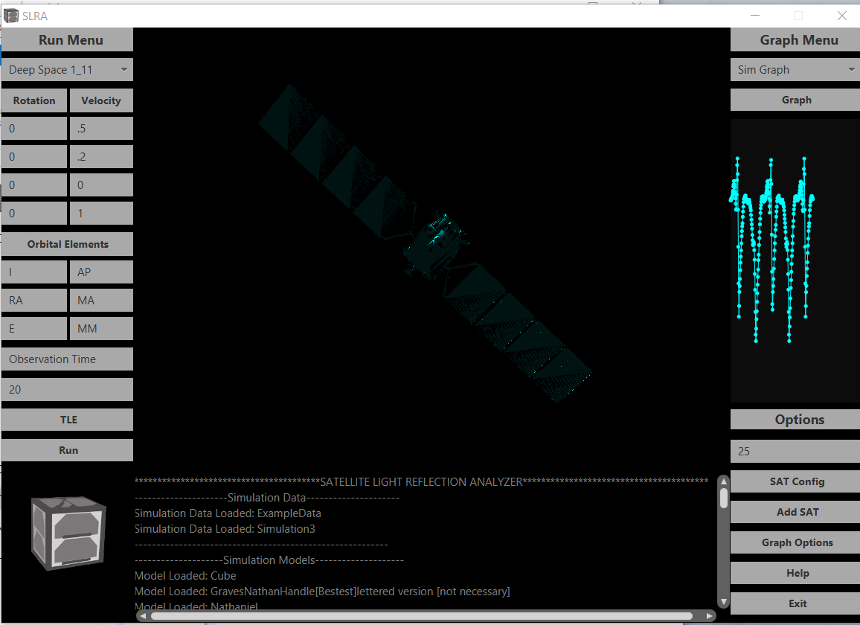
Select data to graph. (new data saved after every simulation)
Select RSO Model
Graph selected simulation in a separate window.
Set Rotation axes for initial orientation and angular velocity
Live graph of RSO brightness. (No units, just shows relative change in brightness for now).
Set initial rotation amount (degrees) or angular velocity (hertz)
Random satellite model from NASA’s website. Default texture is Cyan colored (No particular reason).
Manual orbital elements input… Probably wont use this in the future. Just use TLE
J2000 time of observation. Not implemented yet
Duration of pass. (How long the RSO is rendered)
Does absolutely nothing. Future: set RSO TLE
Sample rate for brightness data. (Hertz)
Run a simulation based on the current parameters
Open a file browser to add a new satellite model.
Output console. Helps with debugging n’ such
Super cool satellite logo that may-or-may-not have been stolen from Spacecraft Development Club…

